Slide 1
Financial robo advisor with tax loss Harvesting
Advisor: Professor Peter Lin
Songyang Guo, Yun Chen, Wanting Mao

Slide 2
Introduction
Objectives:
Construct portfolios based on Black-Litterman model and mean-variance optimization
Increase after-tax returns by conducting Tax Loss Harvesting
Build two web-based user interfaces
For fund managers to optimize the model, do the back-testing and portfolio maintenance
For clients who are willing to invest the portfolio to test their own investment preferences
Strength:
Flexible parameter input with database
Portfolio with tax-loss harvesting
Difficulties:
Interface and adapter for all the parameter and model changes
Website & database design

Slide 3
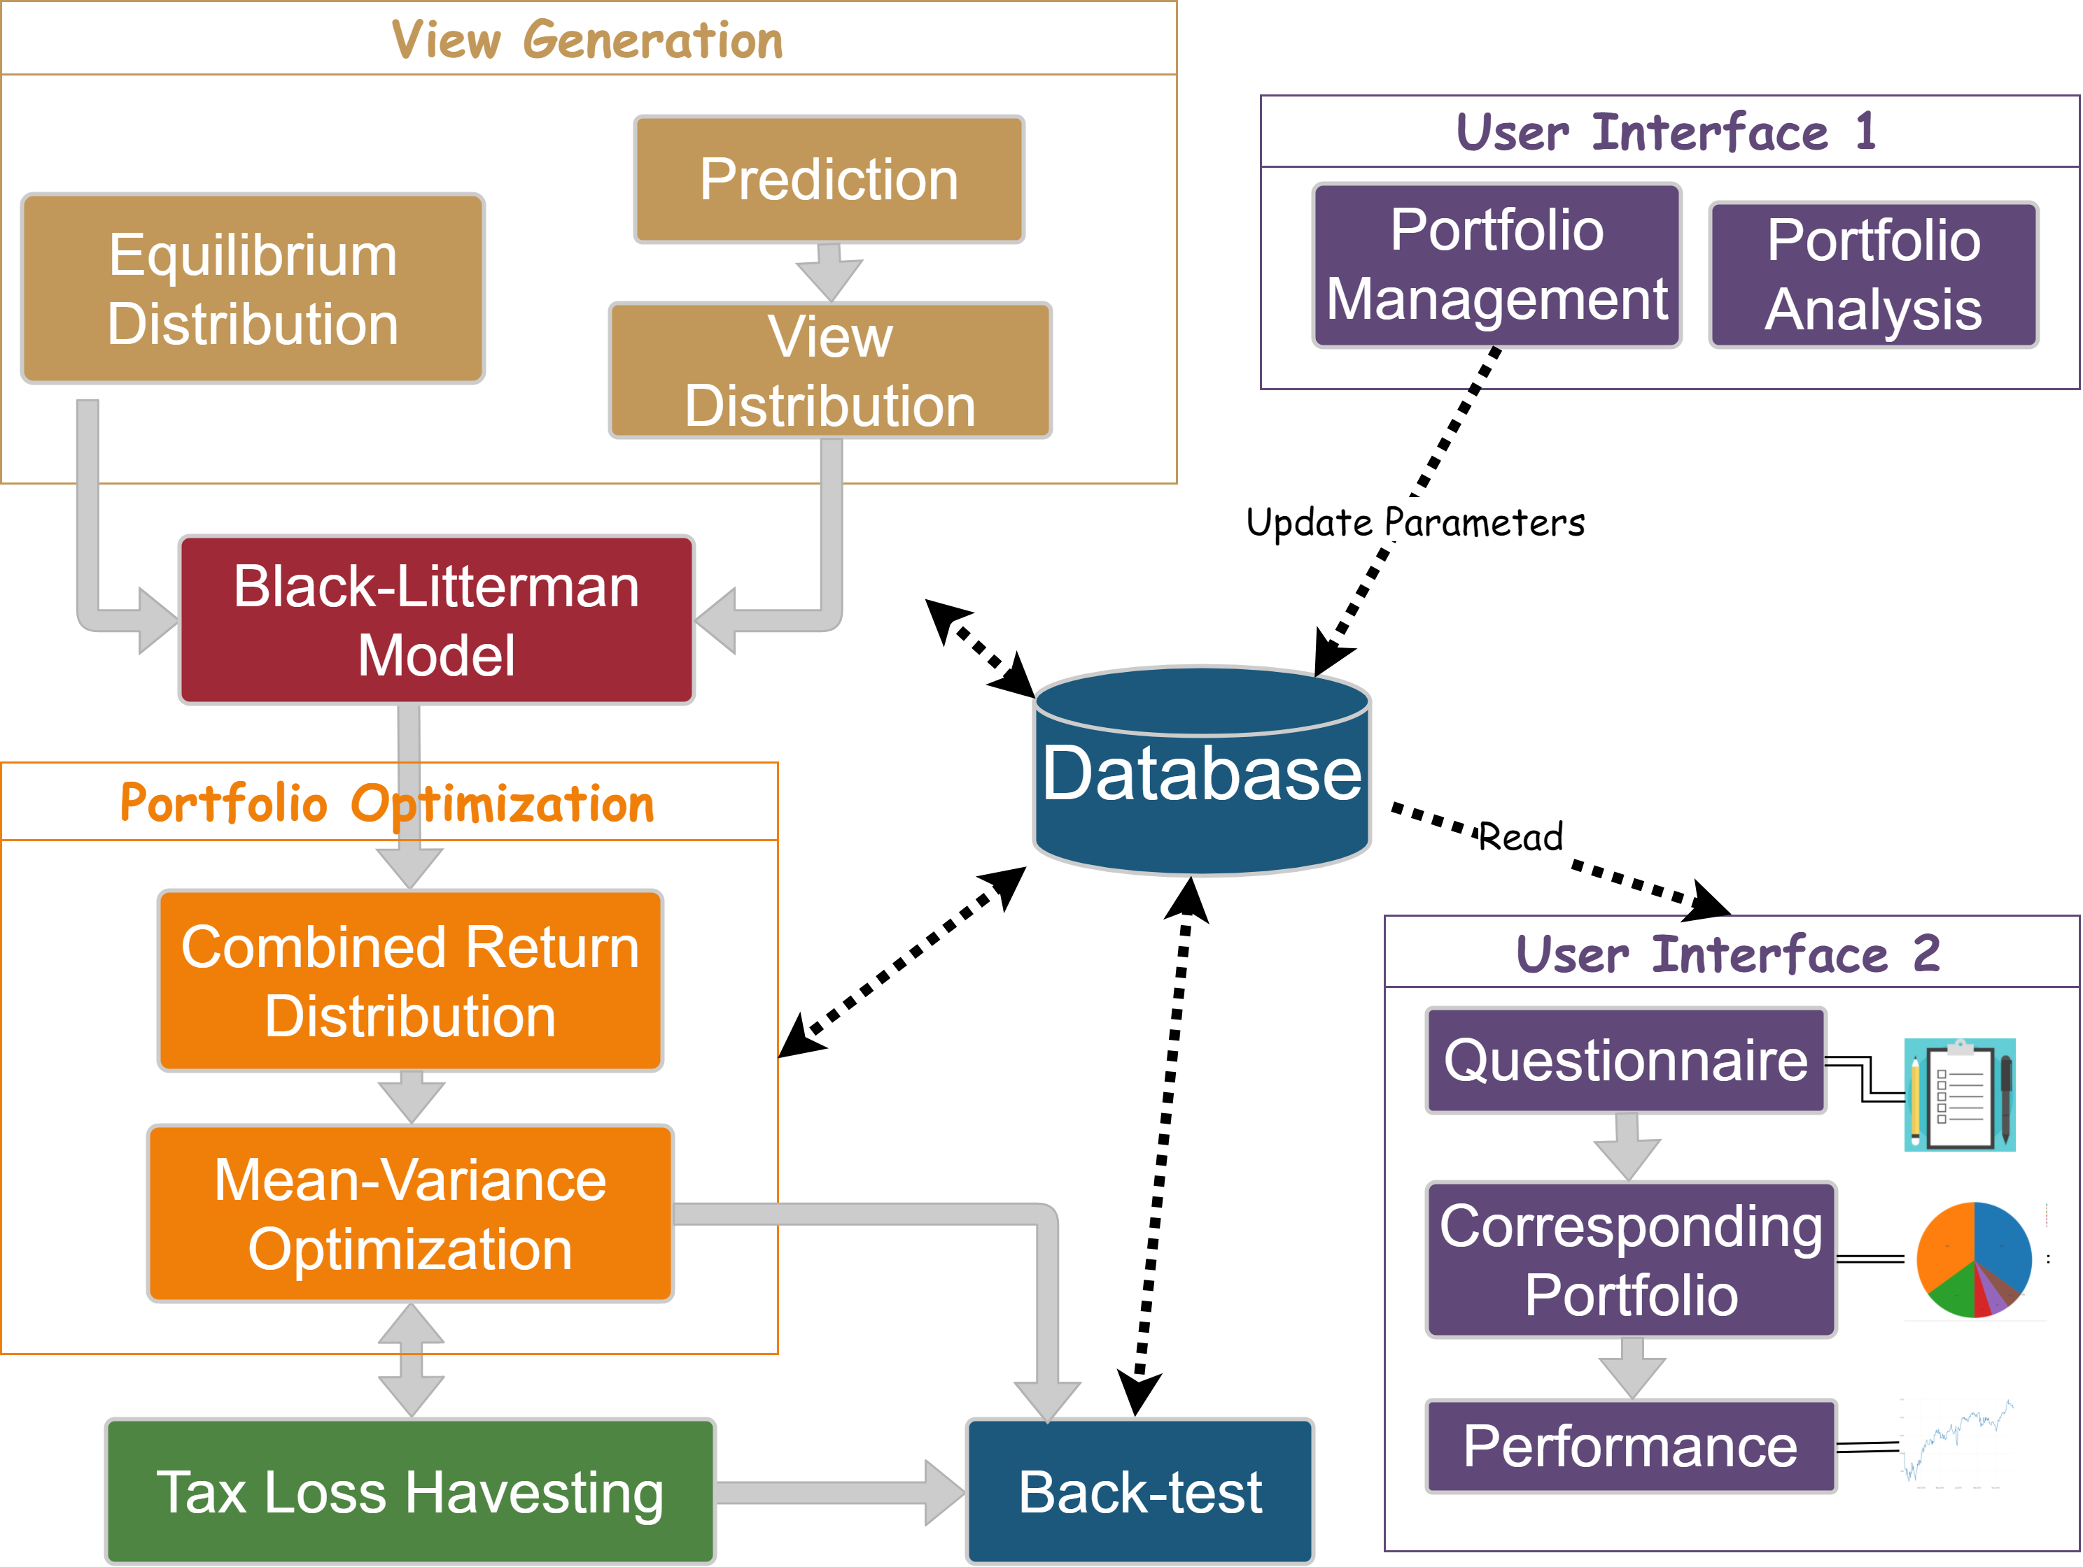
Outlines
Methodology and Algorithm:
Black-Litterman Model
Prediction of Views
ARIMA Model for Prediction
Research Affiliate for Long-term Investment Expected Return
Mean-variance Optimization
Tax-loss Harvesting
Rebalance Method
Database Design
User Interface

Slide 4
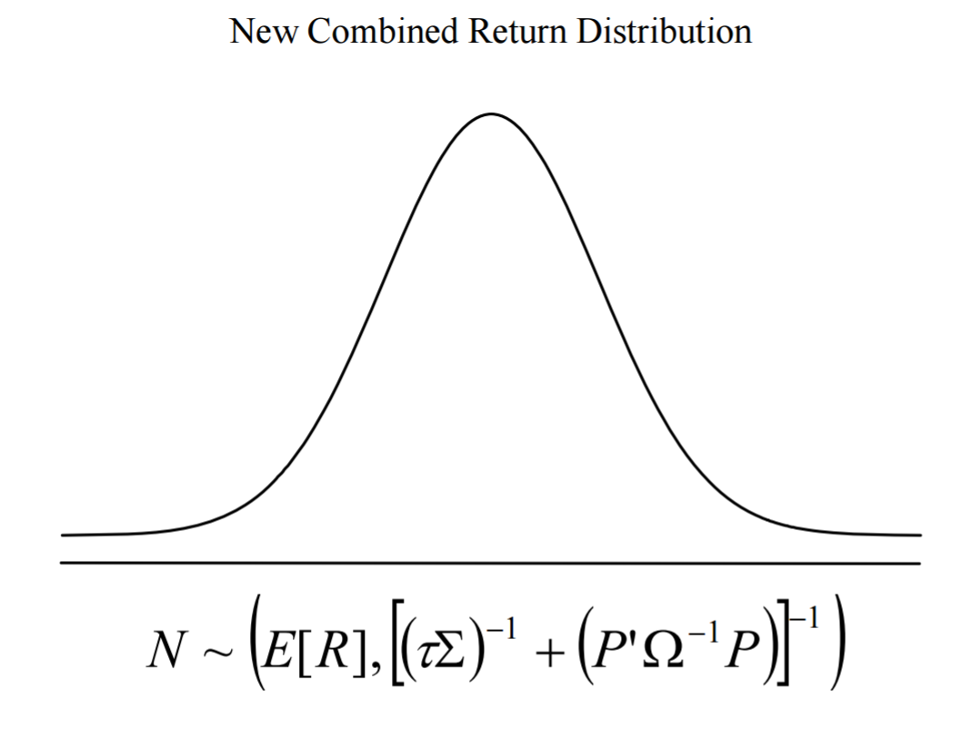
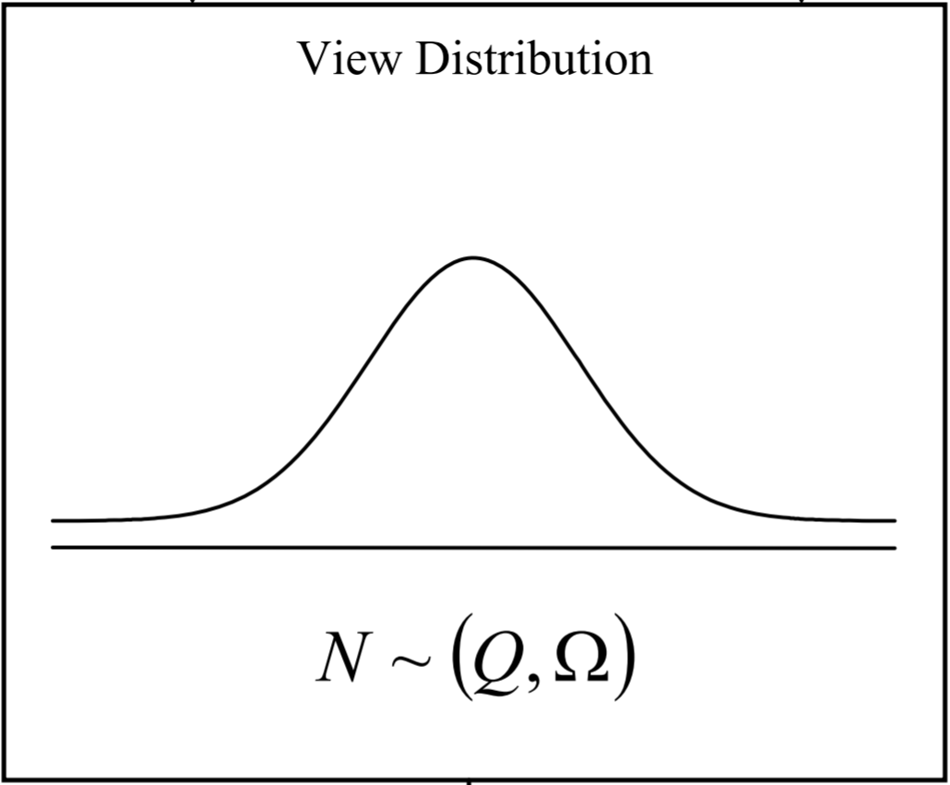
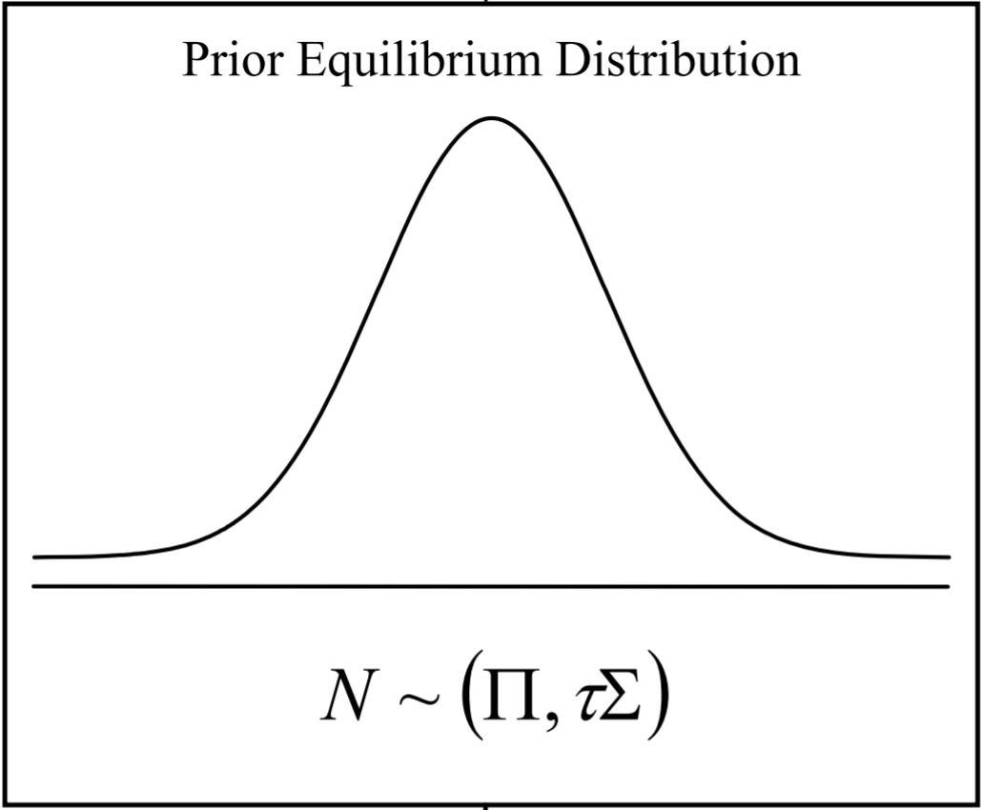
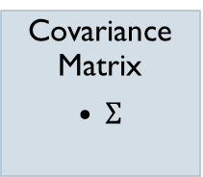
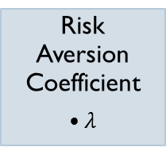

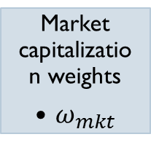
Black-litterman model
Implied return vector
$$Π=λΣω_{mkt}$$
Views
Uncertainty of Views
(P)
(Q)
(Ω)
Risk Aversion Coefficient
$λ$
Covariance Matrix
$Σ$
Market capitalization weights
$ω_{mkt}$
combines

Slide 5
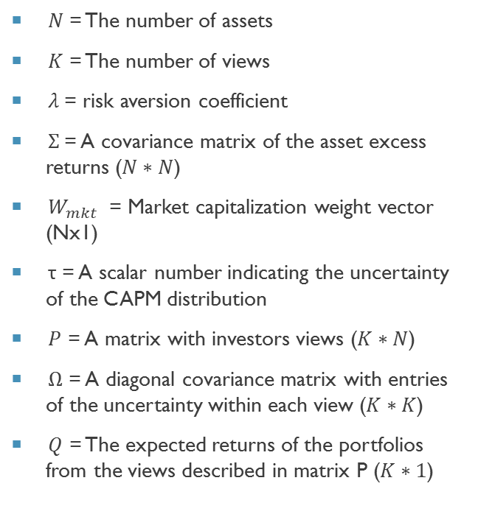
Black-Litterman input and output
Expected new returns (Nx1)
Uncertainty of returns
New covariance matrix
Implied Equilibrium returns (Nx1)
$$Π=λΣω_{mkt}$$
Π=𝜆Σ𝜔_𝑚𝑘𝑡
$$E(R) = {\left[{\left(τΣ\right)}^{−1}+PTΩP\right]}^{−1} [{\left(τΣ\right)}^{−1}Π + P^{T}ΩQ]$$
𝐸(𝑅) = [(𝜏Σ)^(−1)+𝑃^{𝑇}Ω𝑃]^(−1) [(𝜏Σ)^(−1) Π + 𝑃^𝑇 Ω𝑄]
$$M={\left[{\left(τΣ\right)}^{−1} + P^{T}ΩP\right]}^{−1}$$
𝑀=[(𝜏Σ)^(−1) + 𝑃^𝑇 Ω𝑃]^(−1)
$$Σ_{P}=Σ+M$$
Σ_𝑃=Σ+𝑀
$N$= The number of assets
$K$ = The number of views
$λ$= risk aversion coefficient
$Σ$= A covariance matrix of the asset excess returns ($N∗N$)
$W_{mkt}$ = Market capitalization weight vector (Nx1)
τ = A scalar number indicating the uncertainty of the CAPM distribution
$P$ = A matrix with investors views ($K∗N$)
$Ω$ = A diagonal covariance matrix with entries of the uncertainty within each view ($K∗K$)
$Q$ = The expected returns of the portfolios from the views described in matrix P ($K∗1$)
Notes:
Emily

Slide 6
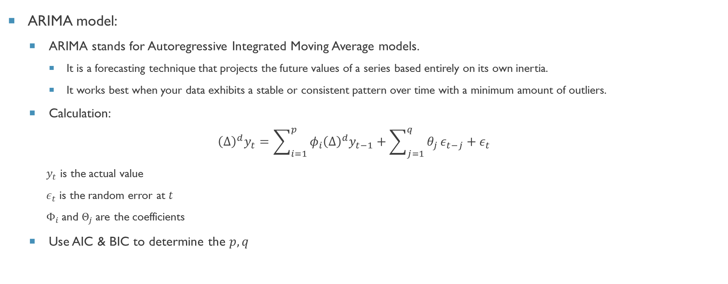
subjective Views
ARIMA model:
ARIMA stands for Autoregressive Integrated Moving Average models.
It is a forecasting technique that projects the future values of a series based entirely on its own inertia.
It works best when your data exhibits a stable or consistent pattern over time with a minimum amount of outliers.
Calculation:
$${\left(Δ\right)}^{d}y_{t}=\sum_{i=1}^{p}{φ_{i}{\left(Δ\right)}^{d}y_{t−1}+\sum_{j=1}^{q}{θ_{j}}}ε_{t−j}+ε_{t}$$
$y_{t}$ is the actual value
$ε_{t}$ is the random error at $t$
$Φ_{i}$and $Θ_{j}$are the coefficients
Use AIC & BIC to determine the $p,q$

Slide 7
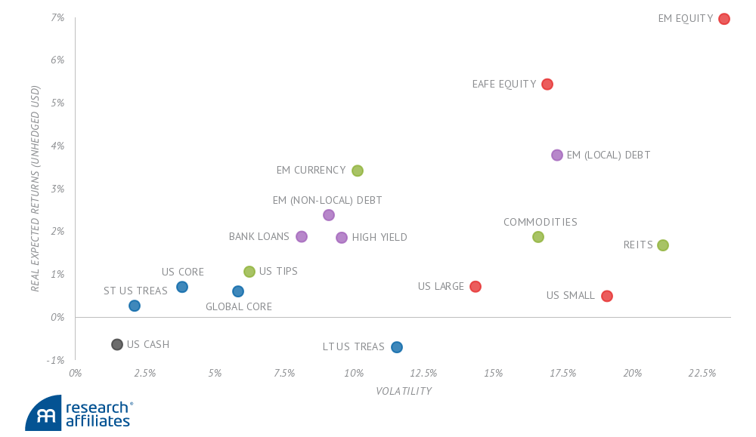
subjective Views
Research Affiliate:
Research Affiliates is a company focus on generating long-term asset allocation. About $179 billion in assets are managed worldwide using investment strategies developed by Research Affiliates.
10-Year Expected Returns of Global Asset Classes
Used as a subjective views with long term investment to stabilize our portfolio
Notes:
Explanation of the institution

Slide 8
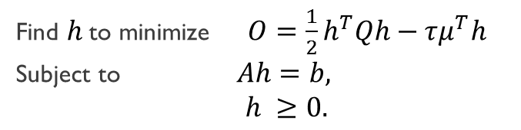
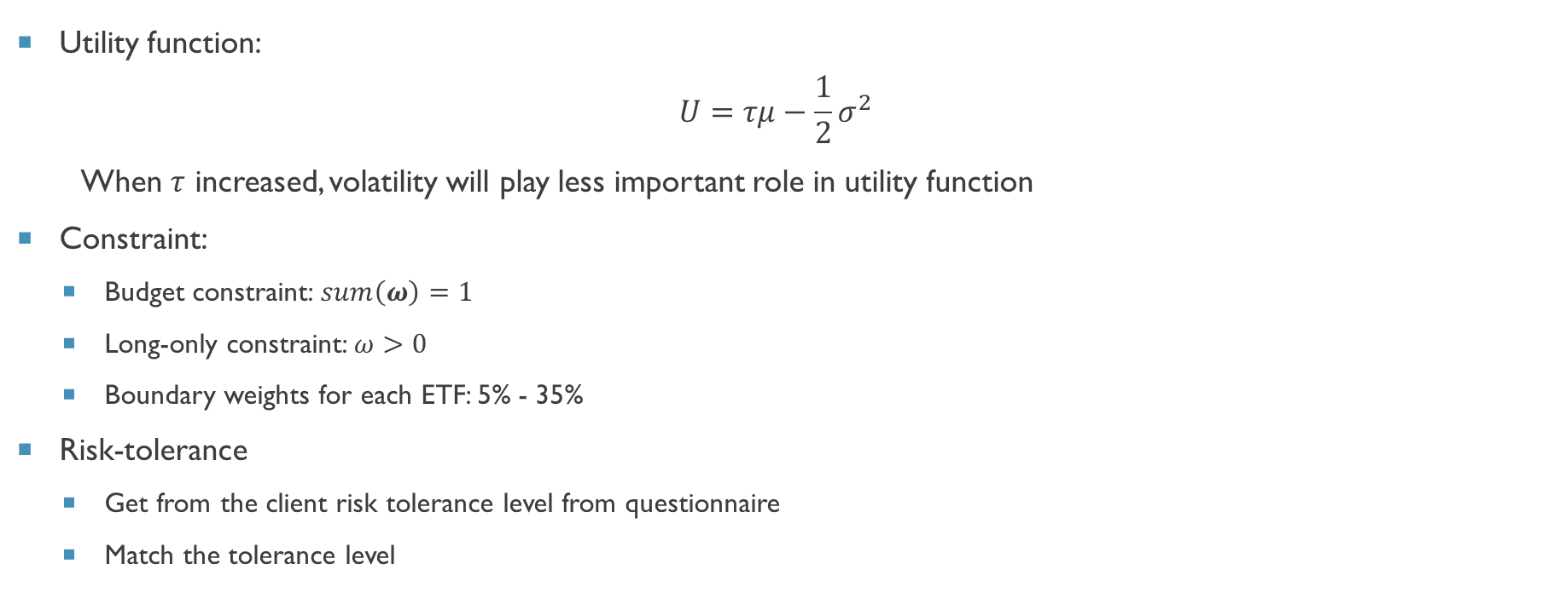
Mean-variance optimization
Utility function:
$$U=τμ−\frac{1}{2}σ^{2}$$
When $τ$ increased, volatility will play less important role in utility function
Constraint:
Budget constraint: $sum\left(ω\right)=1$
Long-only constraint: $ω>0$
Boundary weights for each ETF: 5% - 35%
Risk-tolerance
Get from the client risk tolerance level from questionnaire
Match the tolerance level
Find $h$ to minimize $O=\frac{1}{2}h^{T}Qh−τμ^{T}h$
Subject to $Ah=b,$
$h ≥0.$

Slide 9
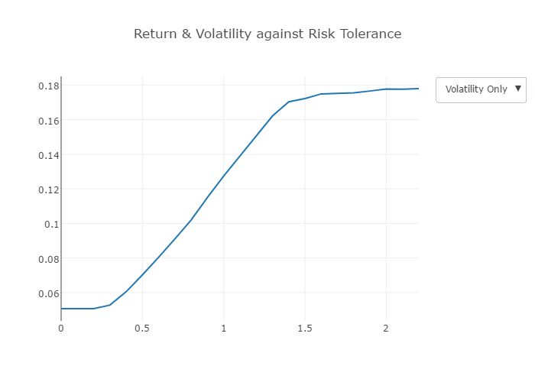


Match the risk tolerance
Our program is designed to generate 5 portfolios with different risk tolerance.
We need to match the risk-tolerance parameter in the utility function to 5 portfolios.
We build portfolios with $τ∈[0.0, 2.5]$, calculate their volatilities stand for the portfolio risks, plot the chart on the left and then manually match tau with 5 portfolios.
risk tolerance $τ$
Notes:
Explain the ccombination

Slide 10
Rebalance method
Drift:
Total absolute deviation of each asset class from its target
Calculation:
We calculate the Target weights once a month.
Current weights will be influenced by prices changes.
Calculate the absolute deviation and take the sum.
Deviation should be divide by 2
Overweights and underweights would be double-counting.
Rebalance strategy:
Set a drift threshold (= 0.025 for example)
Monthly recalculate the target weight
Daily calculate the portfolio drift
Rebalance when the drift beyond the threshold

Slide 11
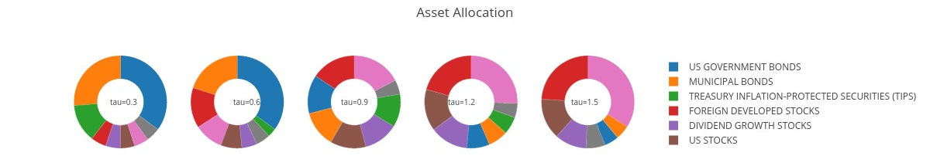
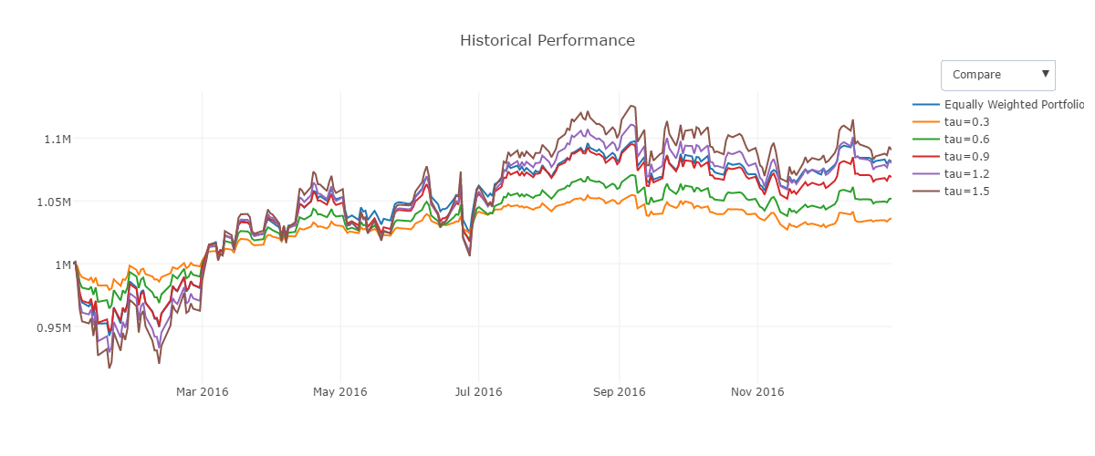
Results

Slide 12
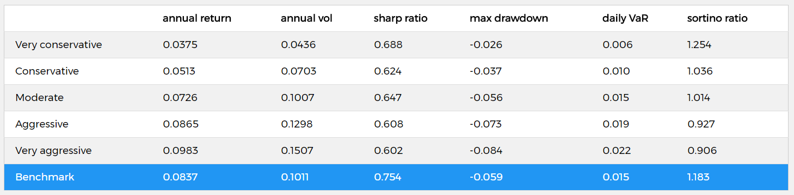
results

Slide 13
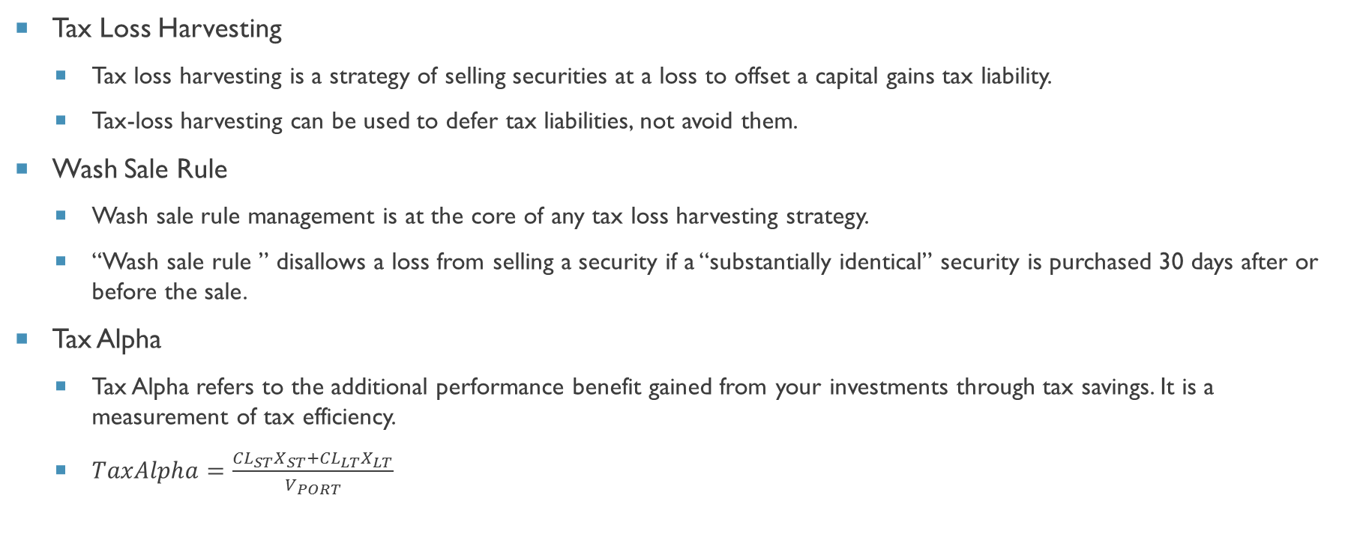
Tax LOSS HARVESTING
Tax Loss Harvesting
Tax loss harvesting is a strategy of selling securities at a loss to offset a capital gains tax liability.
Tax-loss harvesting can be used to defer tax liabilities, not avoid them.
Wash Sale Rule
Wash sale rule management is at the core of any tax loss harvesting strategy.
“Wash sale rule ” disallows a loss from selling a security if a “substantially identical” security is purchased 30 days after or before the sale.
Tax Alpha
Tax Alpha refers to the additional performance benefit gained from your investments through tax savings. It is a measurement of tax efficiency.
$TaxAlpha=\frac{{CL}_{ST}X_{ST}+{CL}_{LT}X_{LT}}{V_{PORT}}$

Slide 14
Strategies and limitations
Limitations
While it’s the easiest method to implement, it has a major drawback: no market exposure—also called cash drag.
This method throws off an investor’s desired asset allocation.
Portfolio may get lower return due to the market price of switchback ETFs.
Switch back
Strategies
Delay reinvesting strategies | Delay the harvest for 30 days.
Reallocate strategies | Reallocate the cash into entirely different asset classes.
Switch back strategies | Switch back to ETFs from the replacement security.

Slide 15
Switch back strategy
 | IEF | MUB | SCHP | VEA | VIG | VTI | VWO | XLE
Highly Correlated ETF | TLT | TFI | TIP | SCHF | SCHD | MGC | PXH | VDE
Original | IEF | MUB | SCHP | VEA | VIG | VTI | VWO | XLE | Total
value | 12500.00 | 12500.00 | 12500.00 | 12500.00 | 12500.00 | 12500.00 | 12500.00 | 12500.00 | 100000.00
Year1 | IEF | MUB | SCHP | SCHF | VIG | VTI | PXH | XLE | Total
value | 12825.59 | 12782.21 | 12749.86 | 11927.57 | 13089.19 | 12944.92 | 12396.18 | 12837.99 | 101553.52
Year2 | IEF | MUB | SCHP | SCHF | VIG | VTI | PXH | XLE | Total
value | 13142.26 | 13051.16 | 13395.51 | 13428.42 | 14110.09 | 14546.91 | 13593.51 | 12904.84 | 108172.70
Year3 | TLT | TFI | TIP | SCHF | VIG | VTI | VWO | XLE | Total
value | 12189.14 | 12110.26 | 12156.17 | 15379.52 | 17452.62 | 18569.86 | 12010.82 | 15646.68 | 115515.07
Year4 | IEF | MUB | SCHP | VEA | VIG | VTI | VWO | XLE | Total
value | 15022.57 | 12951.92 | 12349.10 | 14361.17 | 18994.97 | 20702.62 | 12107.64 | 14195.89 | 120685.88
Year5 | IEF | MUB | SCHP | VEA | VIG | VTI | VWO | XLE | Total
value | 14227.31 | 13059.05 | 12014.99 | 13991.57 | 18230.67 | 20385.98 | 10011.14 | 10518.47 | 112439.19
Year6 | IEF | MUB | SCHP | VEA | VIG | VTI | VWO | XLE | Total
value | 13955.54 | 25473.74 | 12348.89 | 14134.70 | 20240.98 | 22882.14 | 11271.20 | 13248.39 | 133555.58
Check Loss
Check Loss
Check Loss
Switch Back
2 years
Sell Portfolio

Slide 16
Scenario for six year investment horizon
 | YEAR1 | YEAR2 | YEAR3 | YEAR4 | YEAR5 | YEAR6
Beginning Portfolio Value($) | 100000.00 | 101553.52 | 108172.70 | 115515.07 | 120685.88 | 112439.19
Ending Portfolio Value($) | 101553.52 | 108172.70 | 115515.07 | 120685.88 | 112439.19 | 133555.58
Harvested Loss($) | 676.24 | 0 | 4716.05 | 2469.14 | 0 | -
Ending Value After Tax($) | 101553.52 | 108172.70 | 115515.07 | 120685.88 | 112439.19 | 132303.52
Tax Alpha(%) | 0.27 | 0 | 1.74 | 0.86 | 0 | -
The average Tax Alpha for the six years is 0.57%.
Assumption:
The combined federal and state tax rate for short term capital gain is 40%.
The combined federal and state tax rate for long term capital gain is 25%.

Slide 17
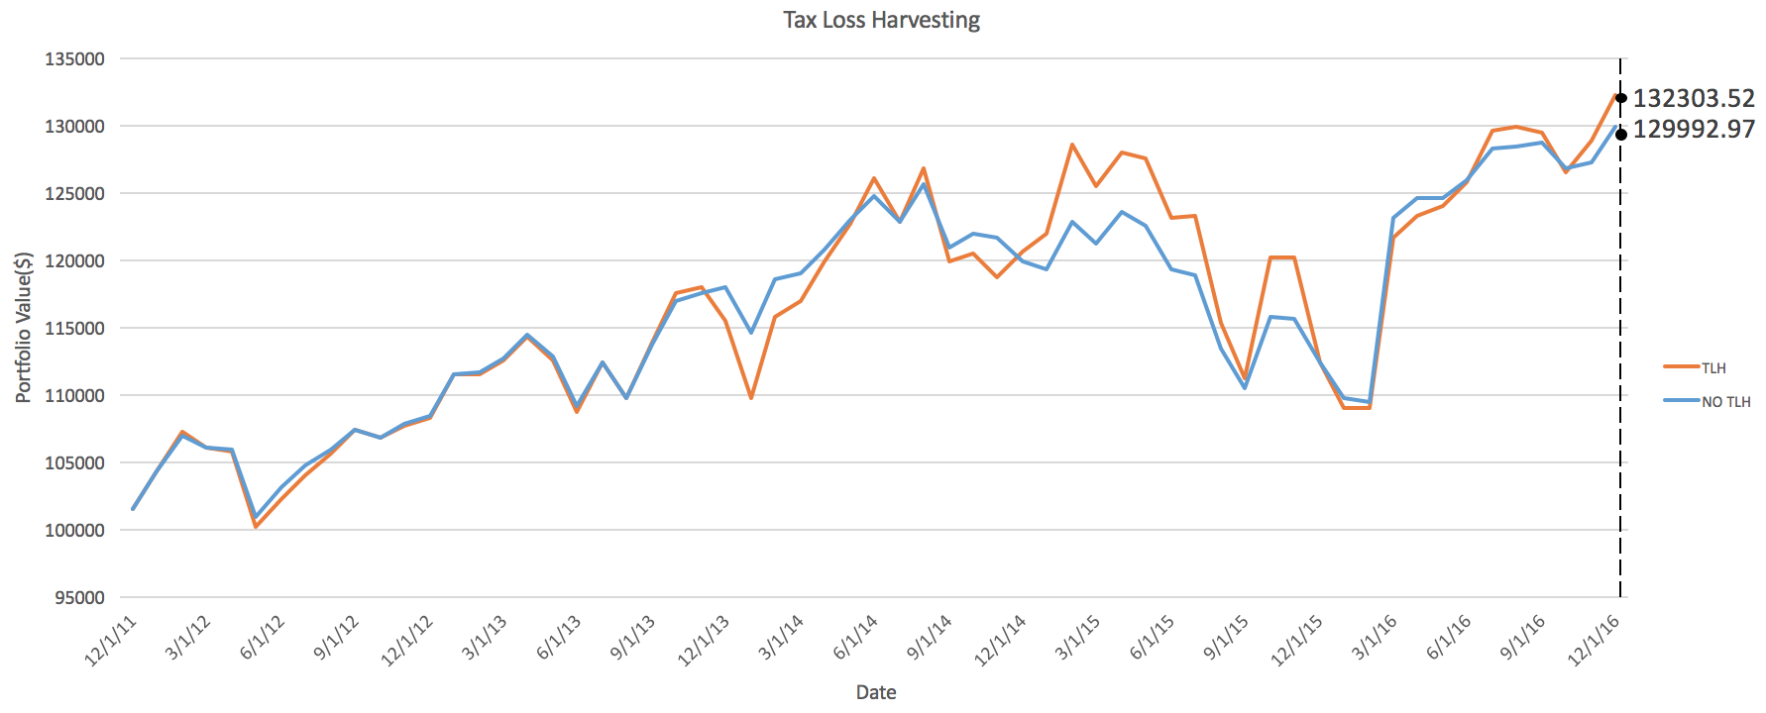
Result of Tax loss harvesting
Tax Paid
 | Ending Value | Ending Value After Tax
TLH | 133555.59 | 132303.52
NO TLH | 139990.63 | 129992.97
Back-testing period: 12/31/2011- 12/31/2016
Data frequency: monthly
The annualized return of portfolio with TLH is 0.39% more than which without TLH.
Notes:
Tracking error

Slide 18

Database
Why mongoDB
Store data in json-like documents that can vary in structure
Use dynamic schemas, so we can create records without first defining the structure
Store related information together for fast query access
Our database – RoboAdvisor
Embedded Data Models (“deformalized” models)
4 collections
Collection ETFs
Collection Views
Collection Back-test stores
Collection Parameter

Slide 19
Database – collection ETFs & Views
Collection ETF
Asset type
Summary data
Interception date
Expense ratio
Tax Rates
Historical data
Date
Quote
Tracking error
Adj. Close
Collection Views
Research Affiliates
Long-term expected return
Implied confidence level
ARIMA model
Predicted future return
Implied confidence level
Others
Web crawling from ETF.com
Yahoo Finance API
Download from Research Affiliates
Machine learning

Slide 20
Database – collection Parameter & Back-test
Collection Back-test
Back-test result
Total value of portfolio
Asset weights
Annualized return
Annualized volatility
Sharp ratio
Cash drag
Parameters
Collection Parameter
Ticker list
Views methods
Rebalancing
Frequency
Drift threshold
Risk levels
Tolerance levels
Managers can test their new strategies through managers’ interface. The testing results are stored in this collection. If the result is OK, they can confirm the strategy to collection Parameter.
Read by clients’ interface,
Can be changed through managers’ interface

Slide 21
Interfaces
For Clients
Shows the product introduction
Provide a questionnaire – accessing risk tolerance
Shows the corresponding financial plan and historical performance
For Managers (to test new strategies)
Select assets (ETFs) for portfolio construction
Add or remove Views
Match risk tolerance with 5 τ
Backtest & portfolio analysis
Confirm the strategy to clients’ interface
Change rebalance methods
HTML
CSS

Slide 22
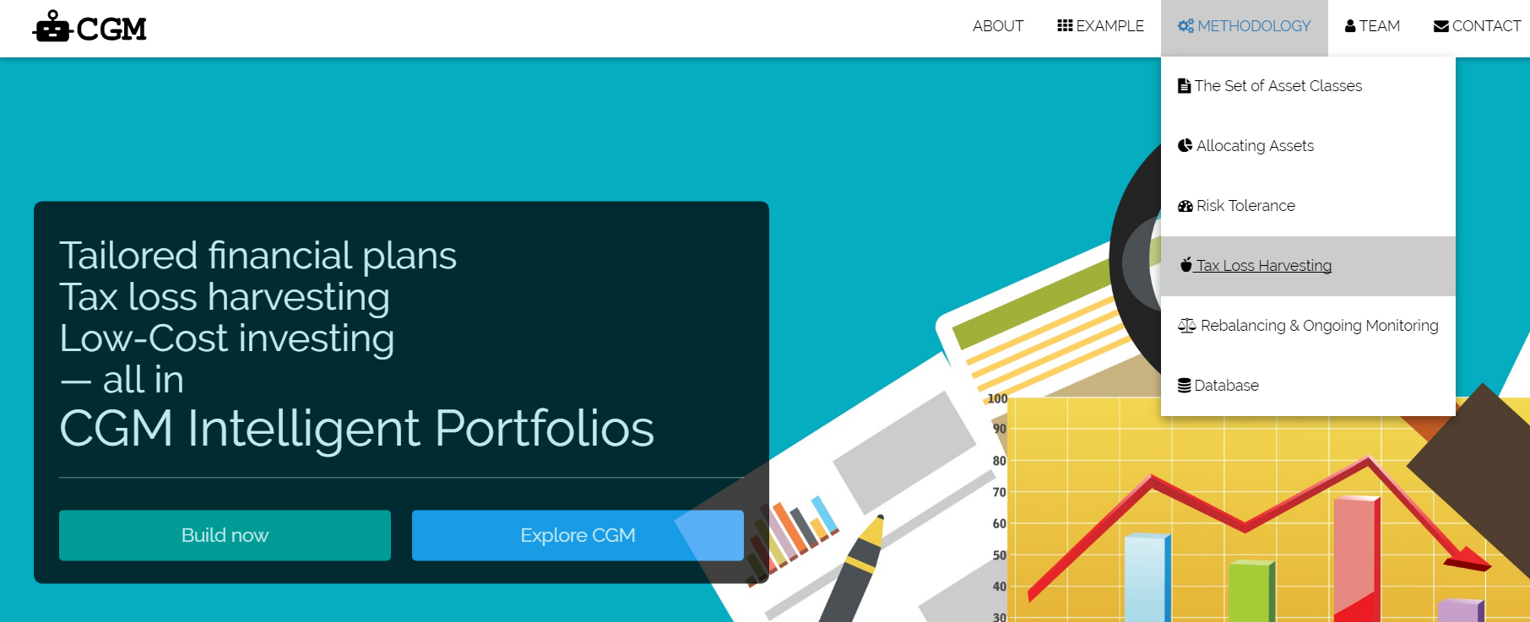
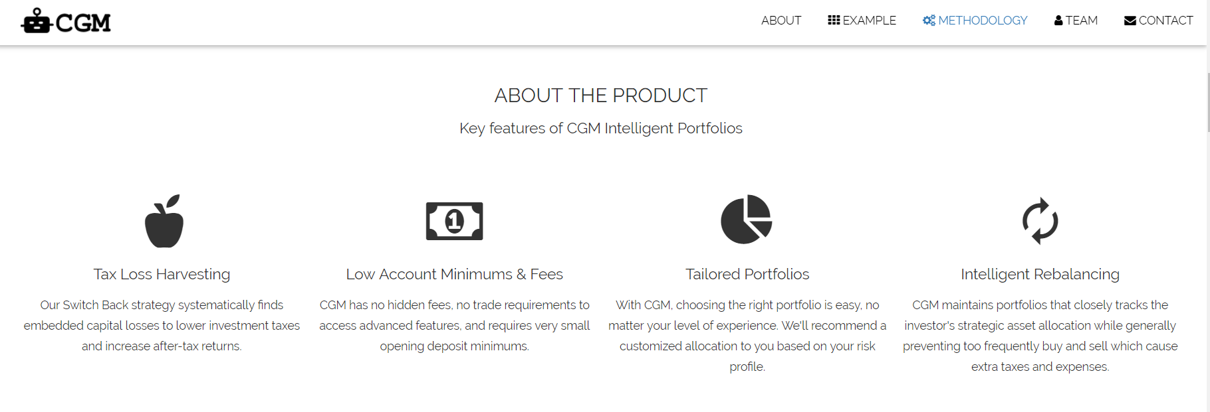
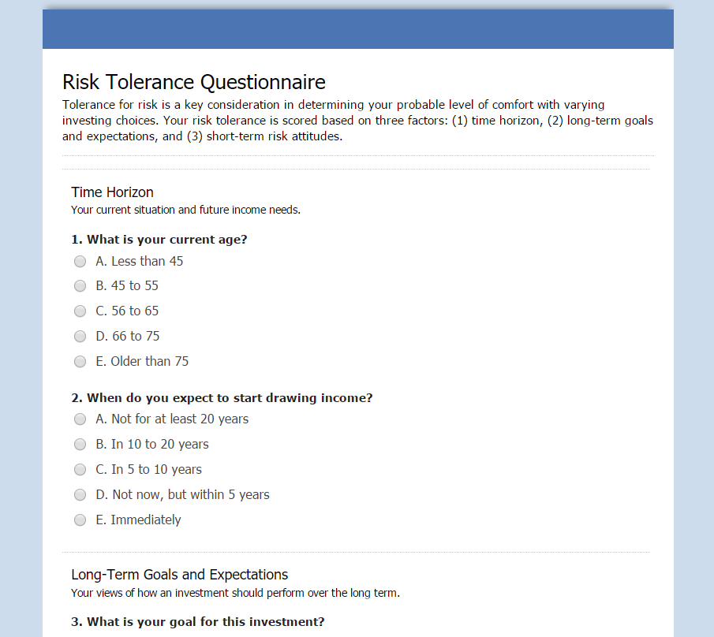
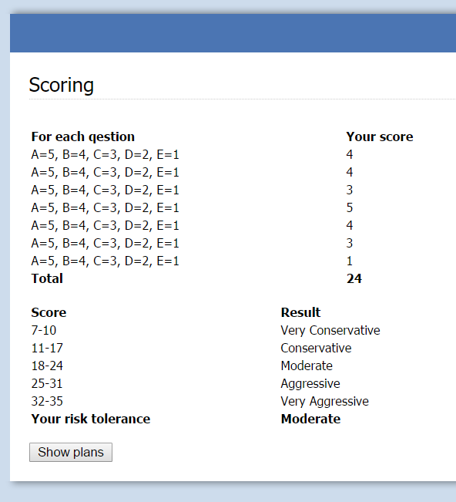
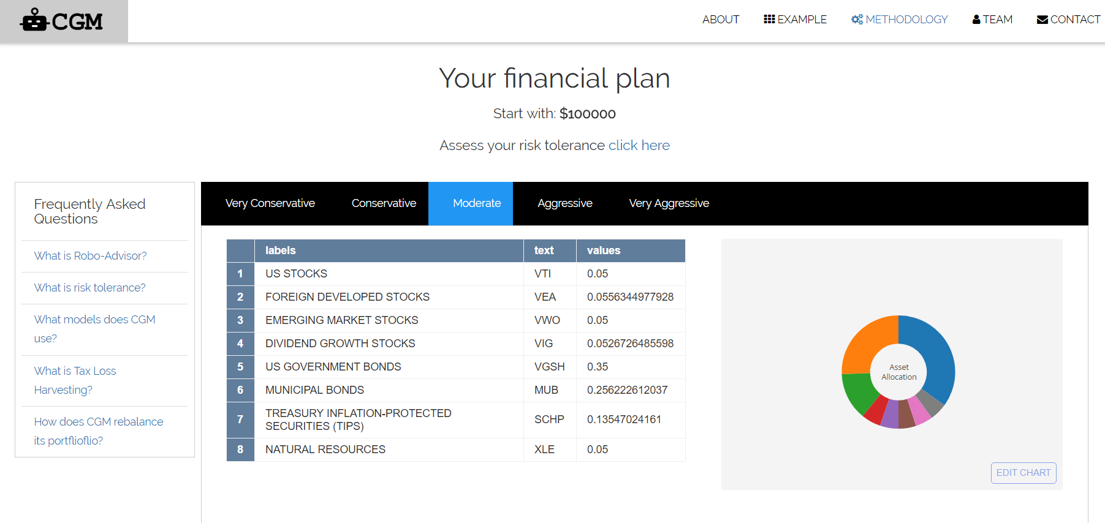
Interface for Clients

Slide 23
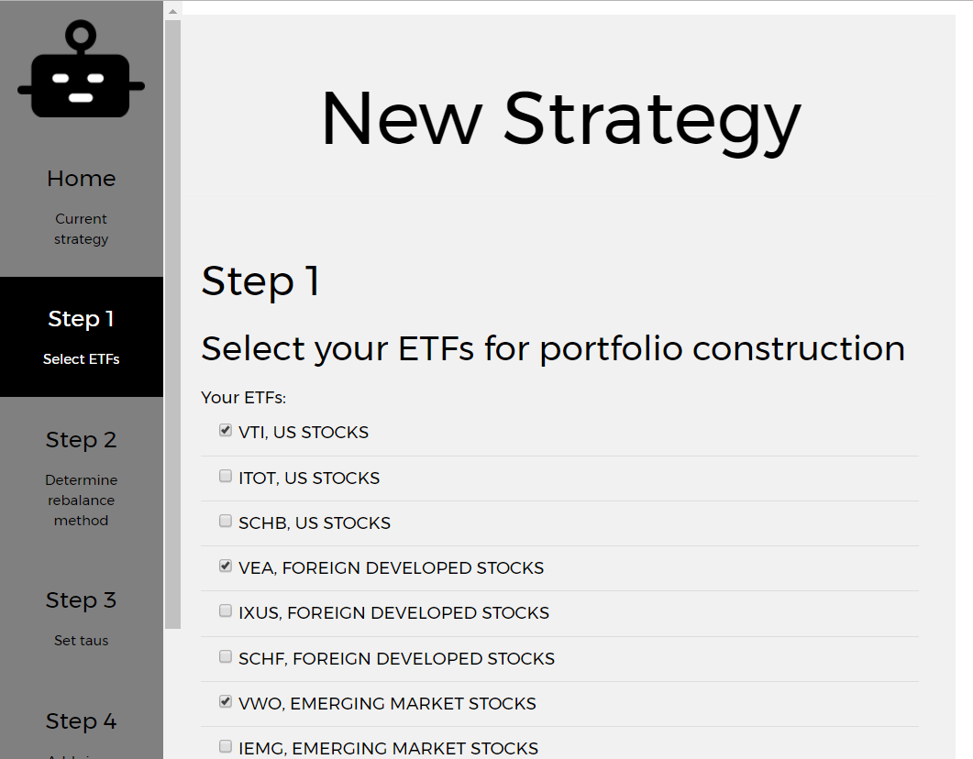
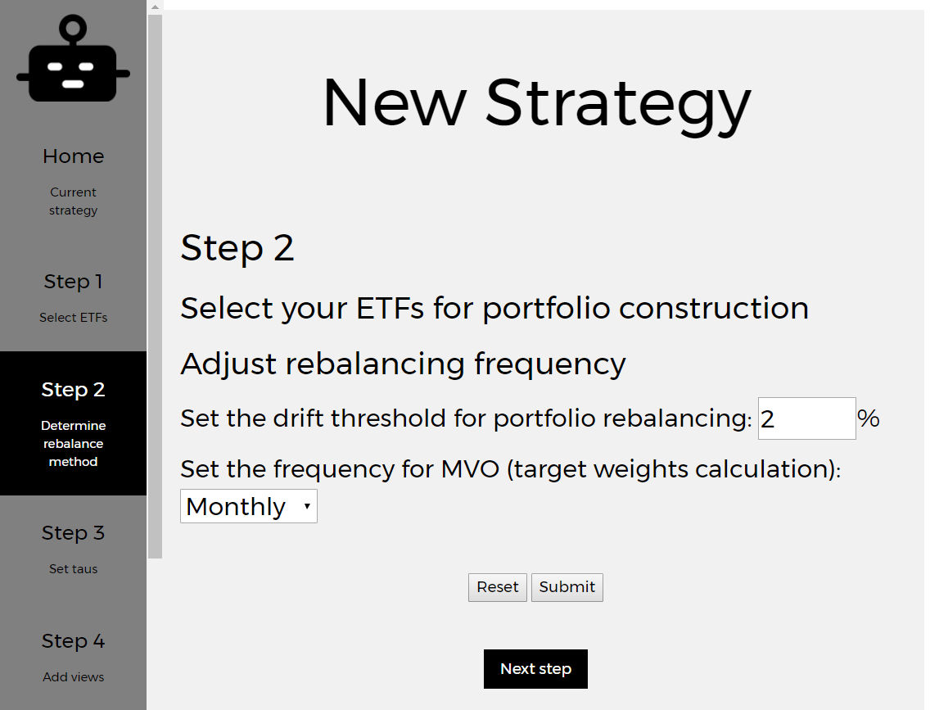
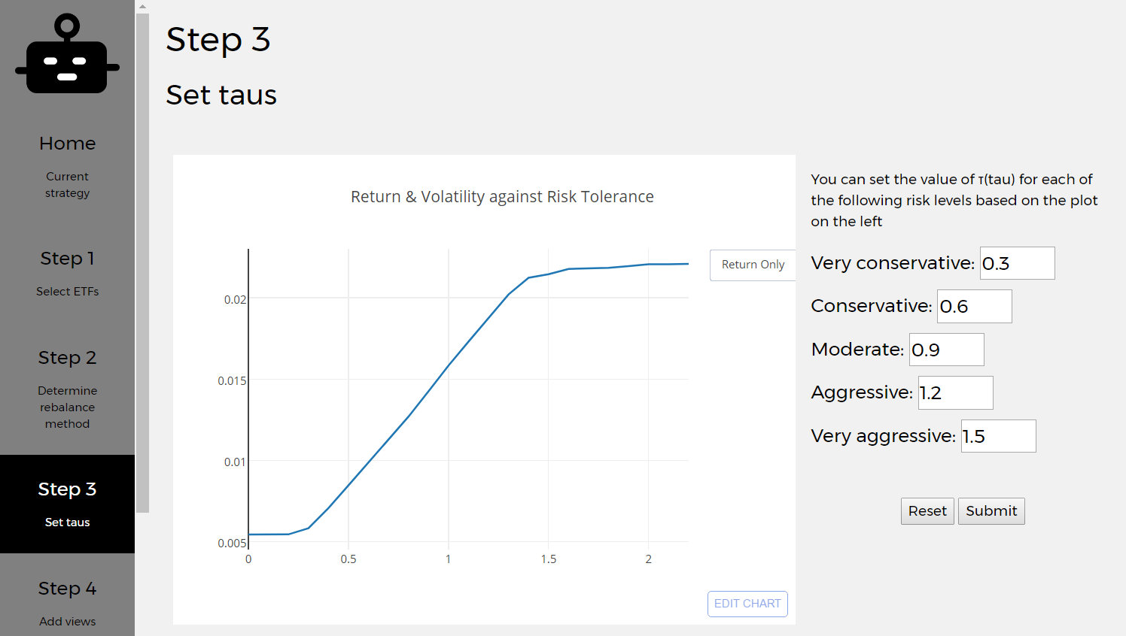
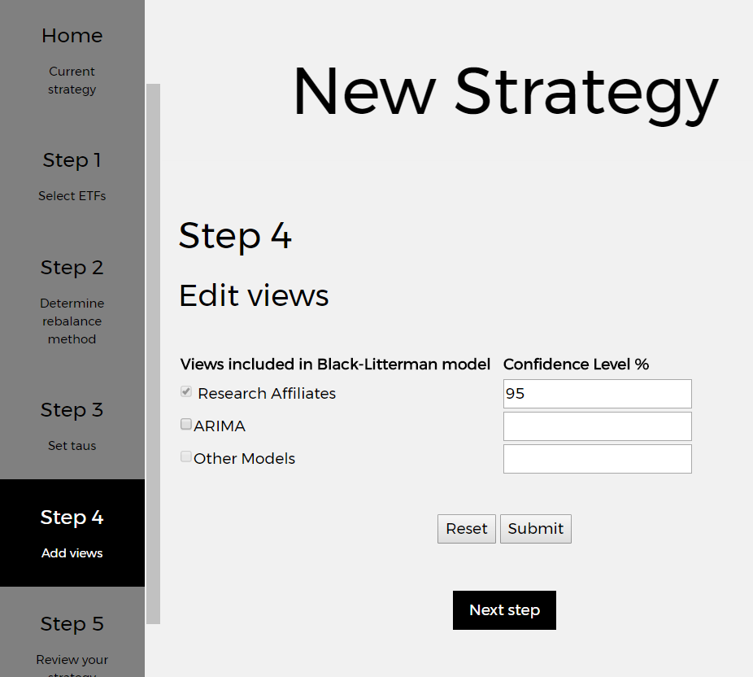
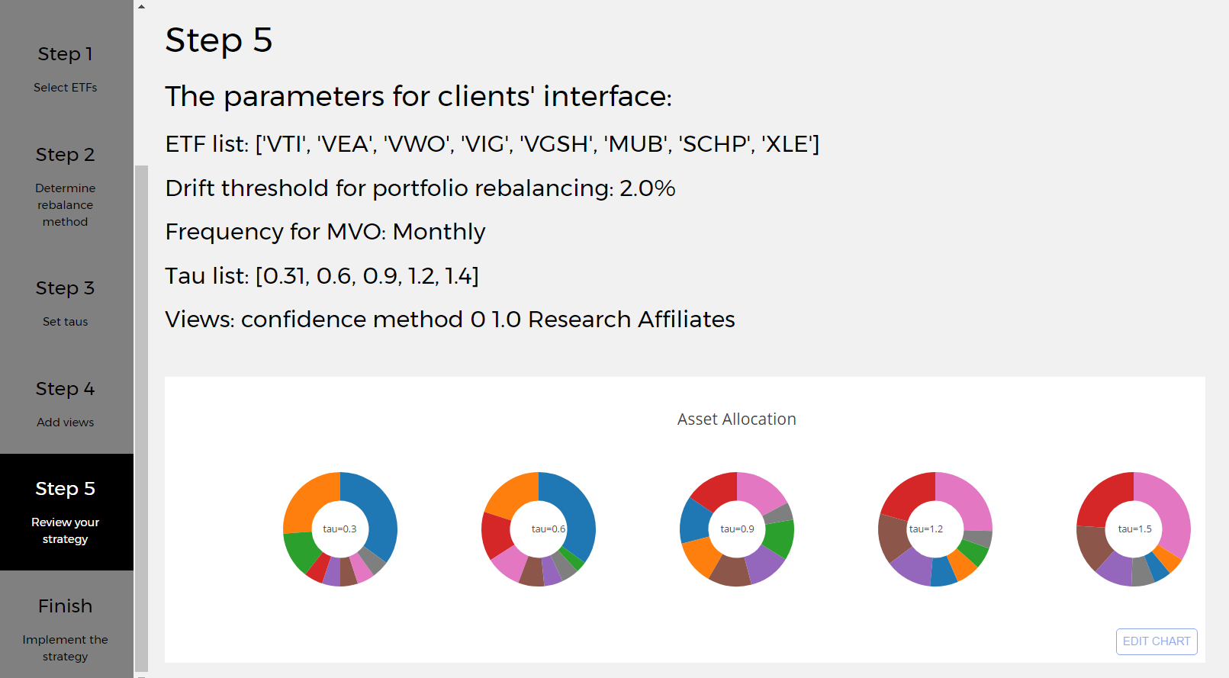
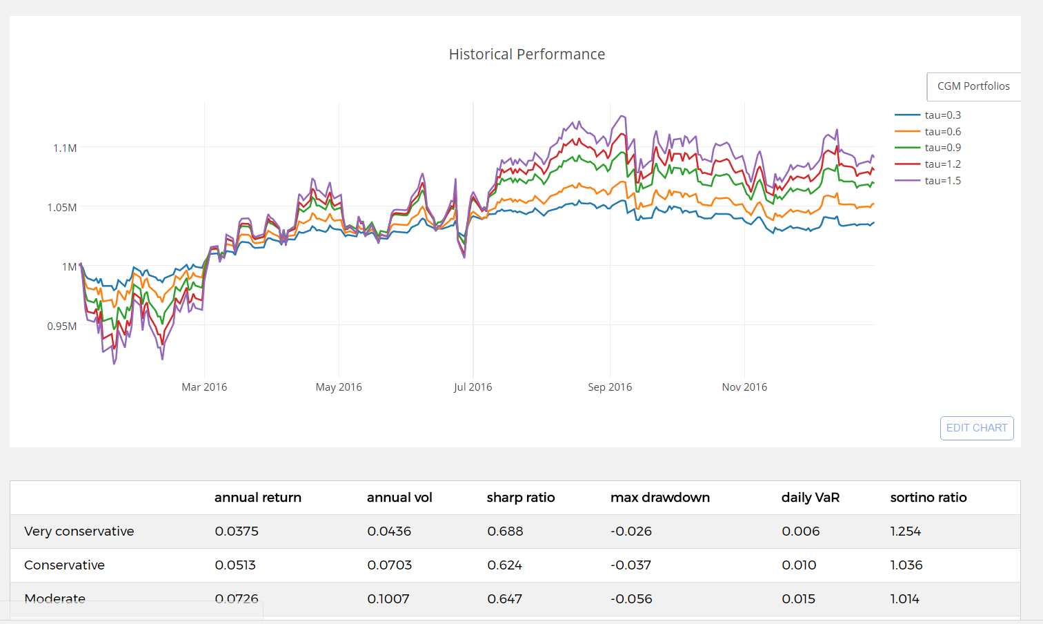
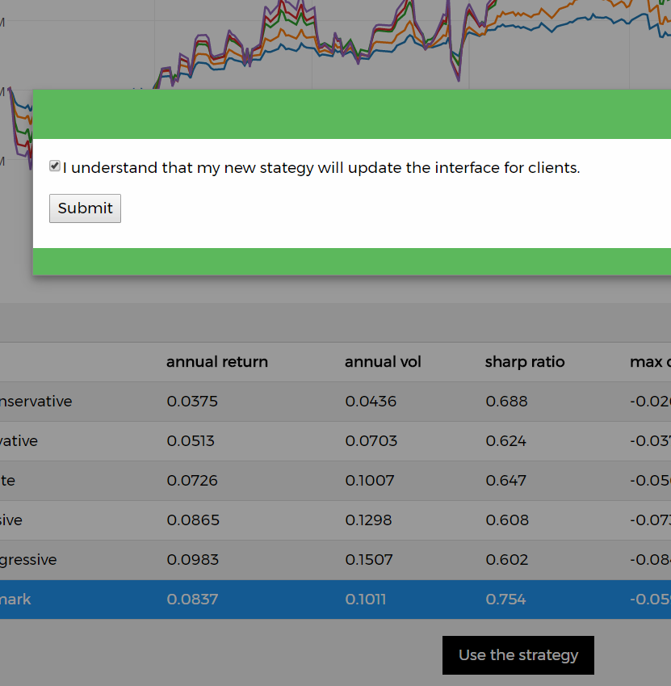
Interface for managers

Slide 24
Achievement
ARIMA model is not a proper model for prediction based on the study of this and last semester.
Increased the annualized after-tax return of portfolio by 0.39% by implementing Tax Loss Harvesting strategy.
Provided a managers’ interface that managers can build and test new strategies.
Created a user-friendly clients’ Interface which enables the clients to build customized financial plans by just few clicks.
Used Mongo database, which is efficient in reading and where the data are updated on a regular basis.

